Slide 1

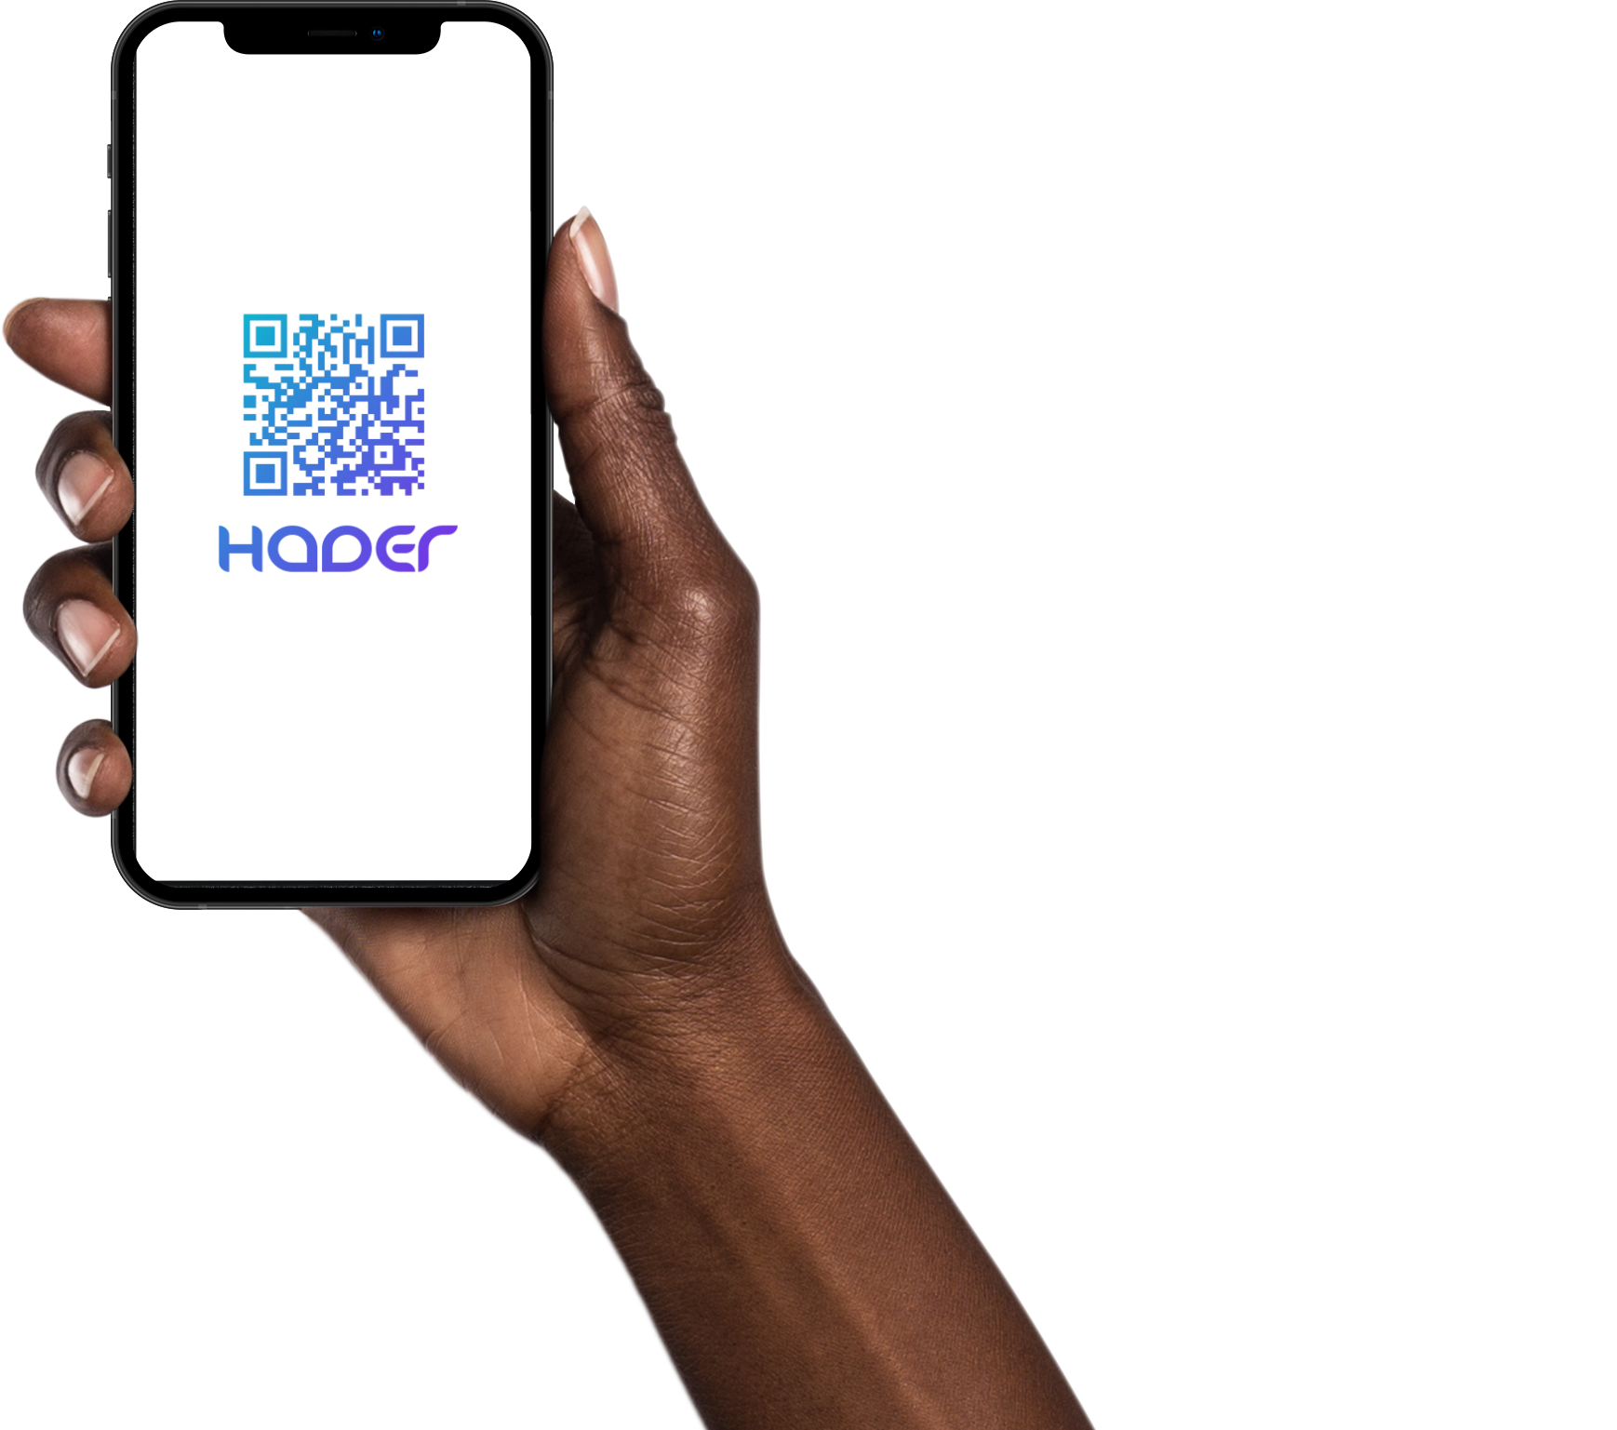
HADER
Senior Project Proposal
Presented by:
Shahad ALTamimi - 2170001466
Lamia AlHammad – 2180001345
Deemah AlRushood - 2180000066
Danah AlDosari - 2180005949
Hajar AlGahtani - 2160003136
Project Supervisor:
Ms. Asiya Abdus Salam
Notes:
Design issues
Benefits of qr
Security (encrypted passwords)
Ux design, usability
Waterfall vs agile.. Etc
Business perspictive, why hader?

Slide 2
Table of Contents
Introduction
Problem Statement
Objectives
Proposed System
Software Project Management Plan (SPMP)
Software Requirements Specifications (SRS)
Software Design Specifications (SDS)
Conclusion
2

Slide 3
Introduction
01
3
Lamia

Slide 4
Problem Statement
02
Dana Alaldossari
Taking attendance by hand is inherently slow, inconvenient, and time consuming. We decided to build a mobile app that helps students, instructors, invigilators, and academic affairs track exam attendance.
All parties involved in the exam attendance process will benefit greatly from the HADER application, as most people now own smartphones.
4
Lamia
Notes:
Taking attendance with a pen and paper is inherently slow, inconvenient, and consumes a lot of time. As a result, we decided to create a mobile app that simplifies exam attendance for students, instructors, and invigilators by allowing invigilators to scan students' unique QR codes and share the attendance list with the designated instructor. In the event of absence or lateness to exams, the app also serves as a bridge between the CCSIT administration department and students.
Because the majority of people now own a smartphone, the HADER application will be extremely beneficial to all parties involved in the exam attendance process. We see this as a critical approach for the CCSIT department in order to speed up the attendance process and, more specifically, to return to college and normal everyday life while safely conducting exams in the face of the COVID-19 pandemic.

Slide 5
03
Objectives
5

Slide 6
Aims & Objectives
Facilitate, secure and speed up the attendance process.
Reduce the amount of noise in the exam room.
Utilizing modern technology at the IAU, CCSIT division.
Integrate everything related to exams in one platform.
Facilitate the process of submitting and responding to excuses.
Assisting CCSIT's Academic Affairs Unit by automating the registration of student attendance data during exams.
6
Hajar

Slide 7
04
Proposed System
7
Notes:
Hader exam attendance system is a native mobile application that works on both iOS and Android. It is intended to help students, invigilators, instructors, and the Academic Affairs Department in the college of computer science and information technology. This smartphone app is extremely helpful. When a student enters the examination hall, he/she shows the invigilator their unique QR code, the invigilator scans the student's QR code, and the student's attendance is automatically recorded in the Academic Affairs Unit's databases. This process was facilitated and automated by utilizing the phone and QR codes. Besides, the student can upload their excuses, which will be approved or declined by the Academic Affairs Unit.

Slide 8
Proposed System
Hader is an application for CCSIT. The main purpose of this application is to enable CCSIT students to join their exam room smoothly and without any distraction and enables admins to manage students and Invigilators.
facilitate students and exam units in CCSIT in the Exam attendance process and make them feel comfortable since it will solve the problem of calling each student's name and disturb their focus during exams, saving time.
an authentication method is to provide students’ unique QR Codes.
8
Hajar

Slide 9
05
Software Project Management Plan (SPMP)
9
Deemah

Slide 10



Software Project Management Plan (SPMP)
Schedule Allocation
Process
Model
Resources Acquisition
10
Deemah

Slide 11
Schedule Allocation
Week | Dates | Topics | Deliverables
1 2 | Aug 29th - Sept 2nd Sept 5th – Sept 9th | Proposal discussion | Status Report #1
3 | Sept 12th – Sept 16th | Collecting data and defining the domain of the problem – (Problem statement)
4 | Sept 19th – Sept 23rd | Project Plan (SPMP) | Status Report #2
5 6 | Sept 26th – Sept 30th Oct 3rd – Oct 7th | Midterm report* | Status Report #3 Midterm Report
7 | Oct 10th – Oct 14th | Analyzing phase (System requirements) (SRS)
8 | Oct 17th – Oct 21st | Analyzing phase (System requirements) (SRS) | Status Report #4
9 10 | Oct 24th – Oct 28th Oct 31st – Nov 4th | Initial design (SDS) | Status Report #5
11 12 | Nov 7th – Nov 11th Nov 14th – Nov 18th | Final design | Status Report #6
13 14 | Nov 21st – Nov 25th Nov 28th – Dec 2nd | Final report | Final report
Deemah
Notes:
Here in the schedule allocation, it shows the week, dates, topics, and deliverables for each

Slide 12
Resource Acquisition
Hardware Resources | Smart Phones
 | Laptops
Software Resources | MySQL Workbench
 | Flutter
 | Dart Language
 | Microsoft Office
 | Trello
 | Figma
12
Deemah
Notes:
This is a resource for our project, including smart phones and laptops for hardware. and MySQL Workbench, Flutter, Dart, Microsoft Office, Trello, and Figma for the software resources.

Slide 13
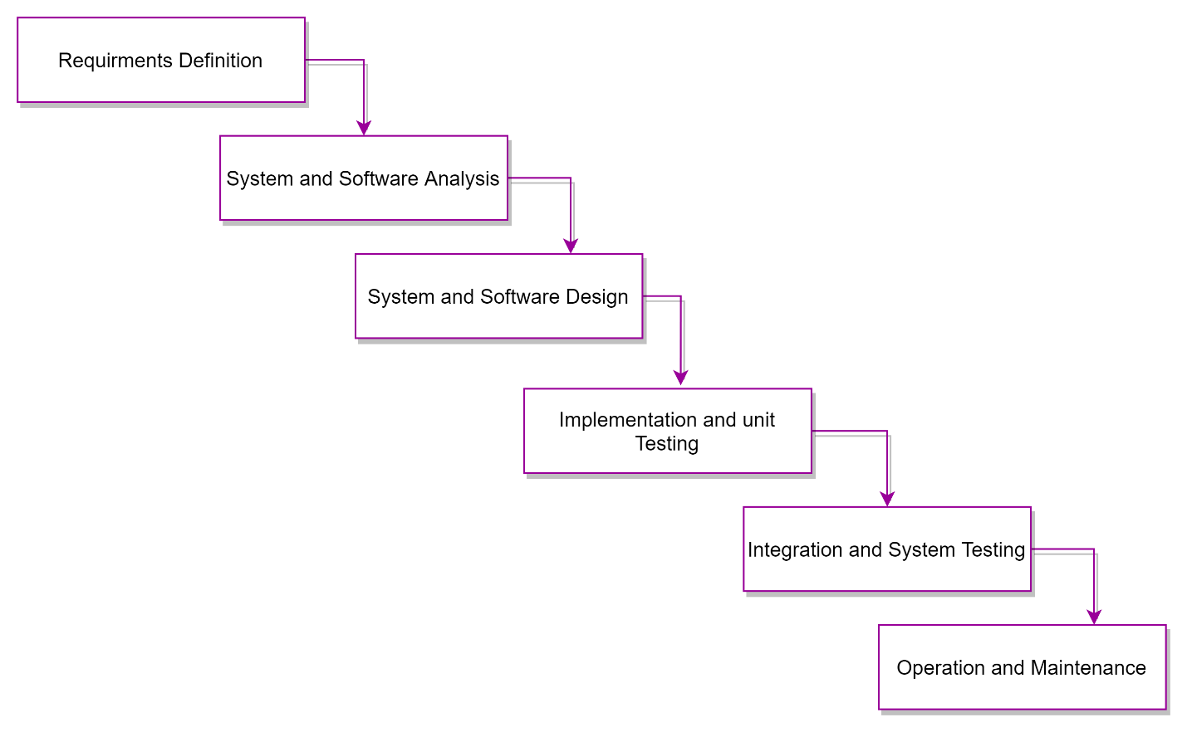
Process Model
Waterfall Model
Deemah
Notes:
After understanding the different software development models, the team has agreed that the Waterfall Model is the best fit, since the waterfall model segregates project activities into linear sequential phases unidirectionally, each phase is dependent on the deliverables of the previous one and validating the deliverables to go to the next phase. Following these phases in a systematic manner will result in a successful software application. which is requirement definition, system and software analysis, system and software design, implementation and unit testing, integration and system testing and operation and maintenance.

Slide 14
06
Software Requirements Specifications (SRS)

Slide 15
Software Requirements Specifications (SRS)
Product Scope
Use Case Diagram
01
02
03
04
System Features
Nonfunctional Requriements
Shahad

Slide 16
Product Scope
Different Users and Authorities
Mark and Export Attendance Sheets
Manage Exam Excuses
Admin, CCSIT Students, invigilators.
Each user has different authorities and functions to preform.
Based on authorities' users can export sheets in various formats to share them via email to any party in CCSIT or IAU.
Excuses are uploaded and managed with HADER Application
Shahad

Slide 17
System Features
Common
Login
Logout
Forgot password
Admin
Manage Students Excuses
Show the Students Absent Percentages
Invigilator management
Admin Profile
Instructors
Show instructor’s information
Instructor Receive notification
Invigilators
QR Scanner to Scan Students QR Codes to Check-in
Show Invigilator Information
Edit, add or delete student’s attendance status
Invigilator devices receive notification of student’s attendance (notification)
Export attendance report
Send Attendance Reports Via Email
Show Student’s Names List
Students
Display QR Code: to be scanned by the exam invigilator.
Show Student Information
Upload exam excuse
View exam excuse status
Shahad

Slide 18
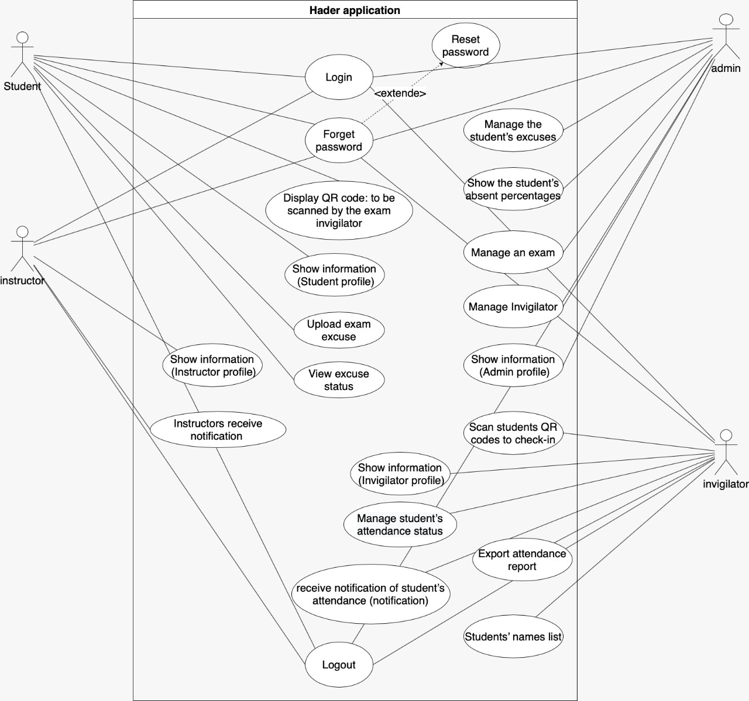
Use Case Diagram
Shahad

Slide 19
Non-functional Requirements
Performance Requirements
Secerity Requiremnts
01
02
03
04
Safety Requirements
Software Quality Attributes
Shahad

Slide 20
07
Software Design Specifications (SDS)

Slide 21
Software Design Specifications (SDS)
Database
Interfaces
Architecture
Design
Danah

Slide 22
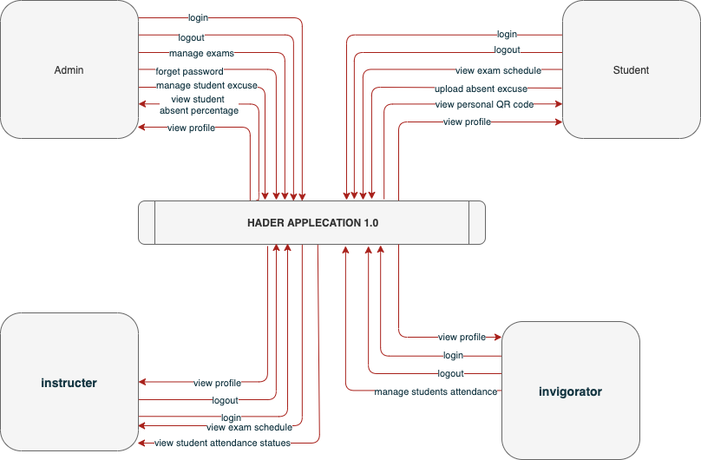
Architecture Context Diagram
Danah
Notes:
The context diagram of HADER application shows the main process and data flow between the system and external entities as shown in the figure.

Slide 23
Database
Database Description
Relationship Diagrams
Provide overview of each entity in the
database
Contains the EER and ERD Diagrams
Provide detailed information of the database contents
Show the relationships between the entities
Data Dictionary
Database Schema
Danah

Slide 24
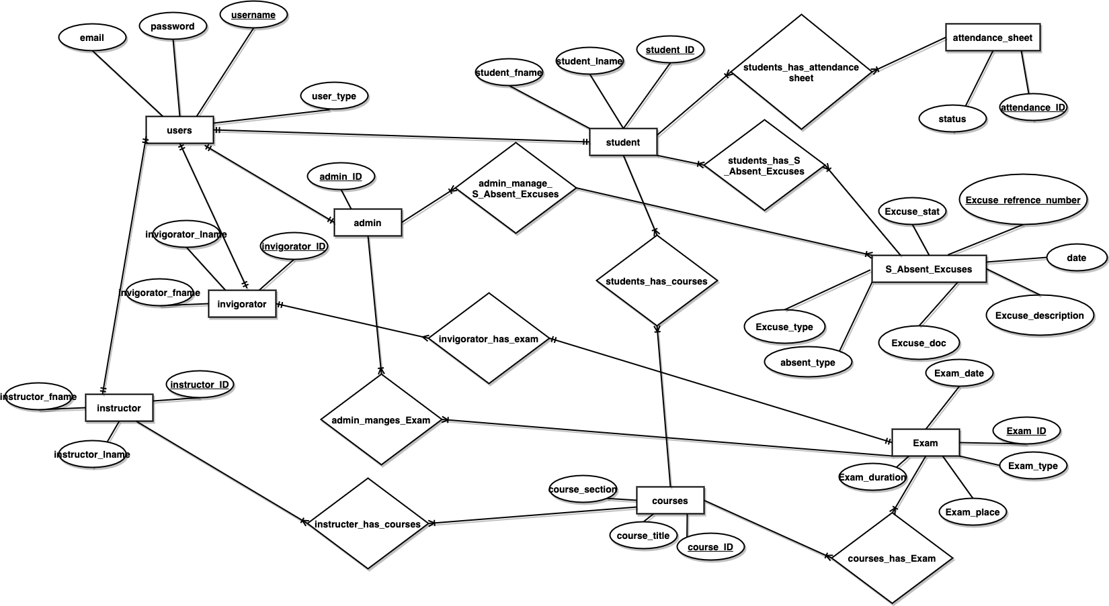
Design
ER Diagram
Danah

Slide 25
Interfaces
Danah

Slide 26
Interfaces
Student Interfaces
Commen interfaces
Invigilator Interfaces
Admin Interfaces
Instructor Interfaces
Danah

Slide 27
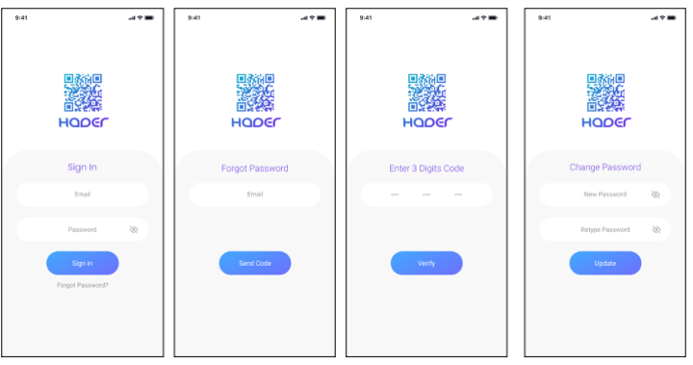
Common Interfaces
Login, forgotten password, Enter Digit Code, Change the password interfaces
Danah
Notes:
Login: The user logs in by entering the email and password.
Forgotten password: If the password is forgotten, the user must enter there email and a Digit code will be sent to them.
Enter Digit Code: The user enters the Digit numbers that were sent via email, then confirms.
Change the password: The user enters the new password and types it again to confirm, then update.

Slide 28
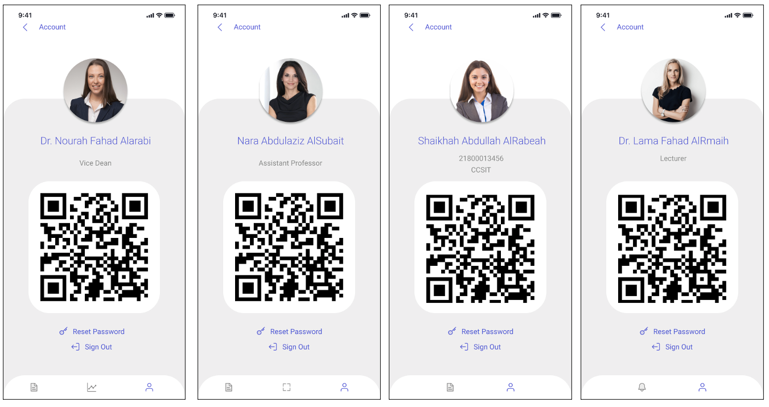
Common Interfaces
Profile Interfaces
Danah
Notes:
Profile: Shows the user's information, name, profile picture, and QR code.

Slide 29
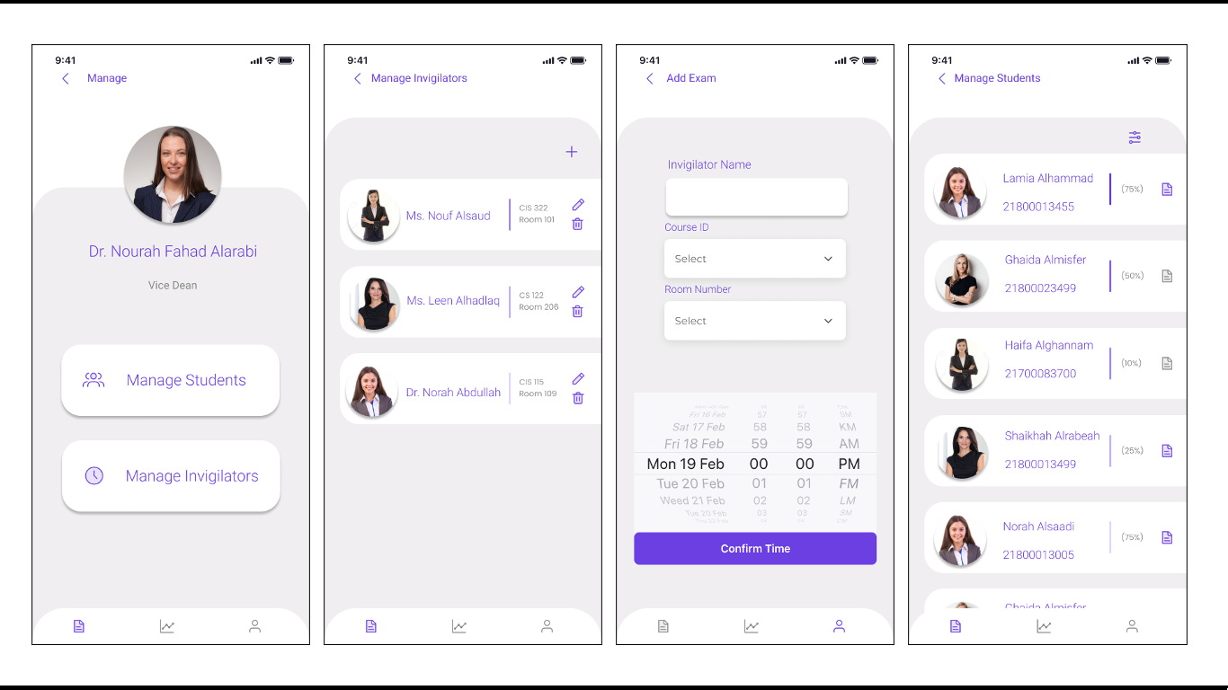
Admin Interfaces
Administration, manage invigilators, adding a new exam, manage student interfaces
Danah
Notes:
Administration: The admin chooses to manage the invigilators or manage the students.
Manage invigilators: a plus sign appears at the top of the list to add a new invigilator to the exam, as well as a list of the names of the invigilators who have been added previously.
Adding a new invigilator: When the plus sign is pressed, this page appears, and the exam information is entered, such as the name of the invigilator, room number, course ID, date, and time.
Manage student: A list of absent students, their percentage of absence, and an icon to view excuses for absence appear.

Slide 30
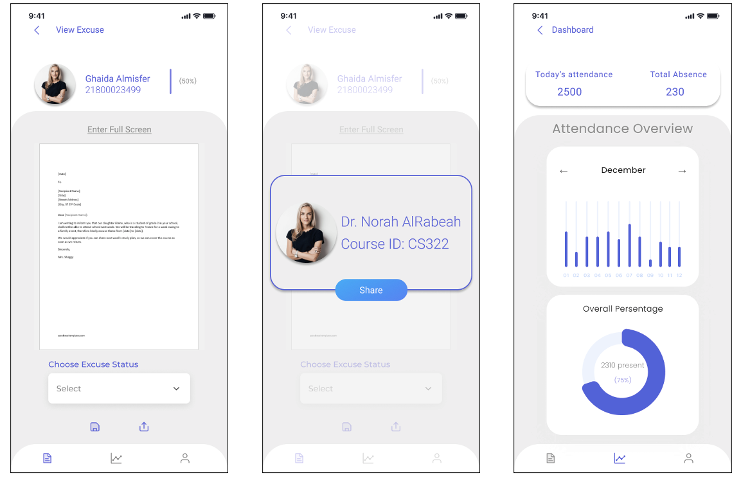
Admin Interfaces
Absence Excuse Management, Dashboard interfaces
Danah
Notes:
Absence Excuse Management: The admin looks at the student’s excuse and determines the status of the excuse, whether it is accepted, rejected, or suspended, and then the excuse is sent to the designated user.
Dashboard: There are general statistics on the number of absent and present students and absenteeism rates.

Slide 31
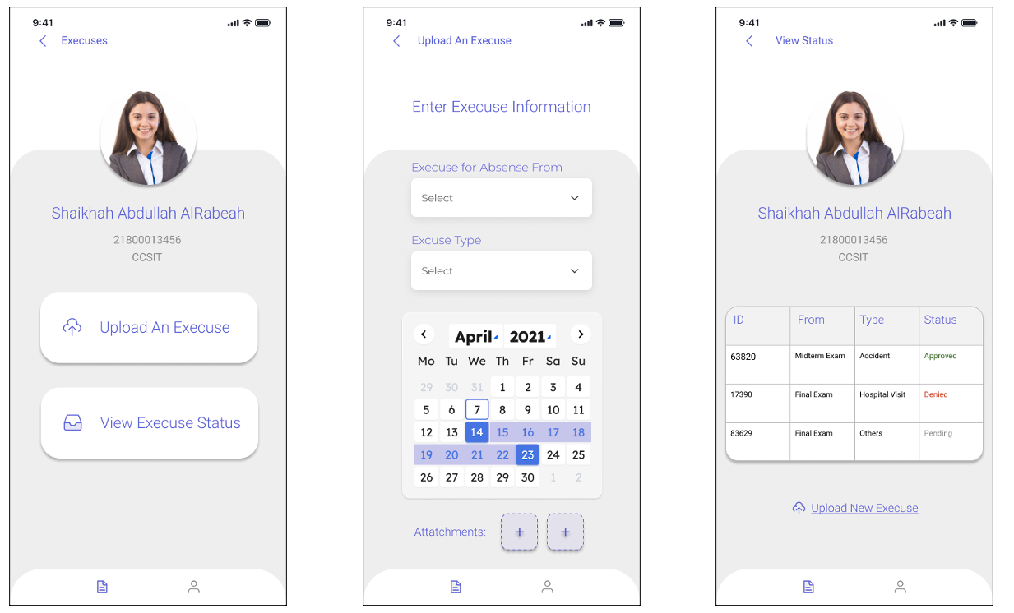
Student Interfaces
Excuses Menu, Submitting an excuse, View Excuse Status interfaces
Danah
Notes:
Excuses Menu: The student has the option to upload an excuse or see the case of an excuse that was previously uploaded.
Submitting an excuse: The student enters the excuse information, such as the reason, type of absence, date, and a photo or file of the excuse.
View Excuse Status: The status of the request for an excuse for absence is shown here

Slide 32
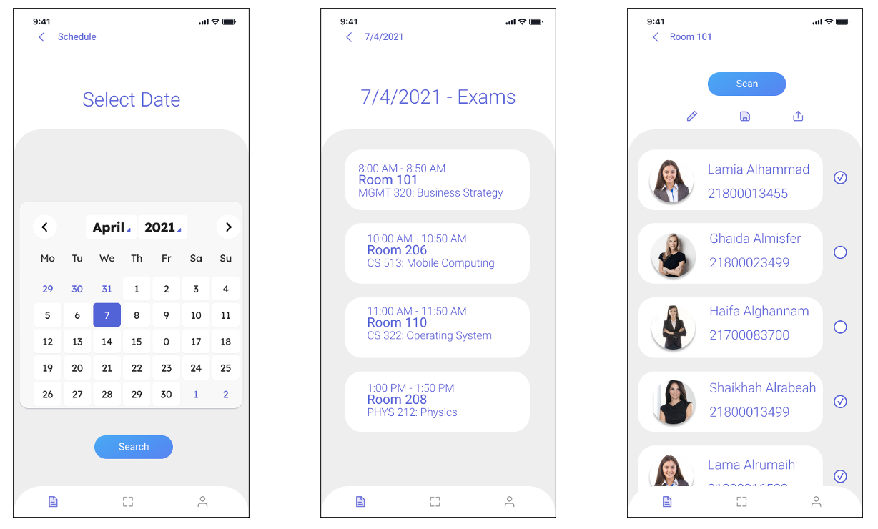
Invigilator Interfaces
Monitoring schedule, List of exams, Today's exam interfaces
Danah
Notes:
Monitoring schedule: The Invigilator chooses the date of the day on which the monitoring will take place.
List of exams: When choosing the date, a list of exams appears with the exam room number.
Today's exams: A list of students whose attendance will be taken in the exam appears and a button to scan the code.

Slide 33
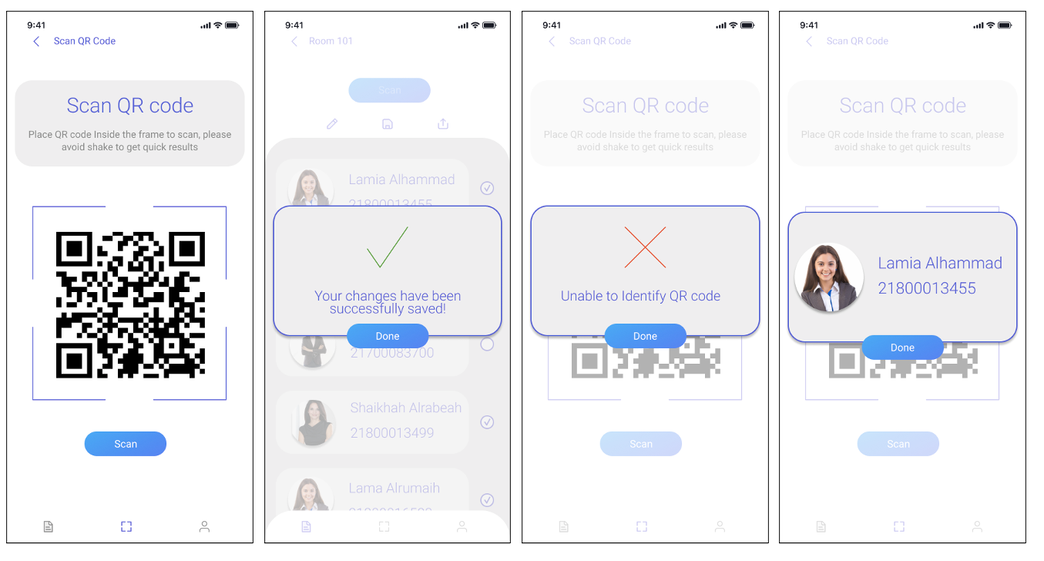
Invigilator Interfaces
Scan a QR code, Error message, Success message, Student identification, Share list interfaces
Danah
Notes:
Scan a QR code: When the “Scan Code” button is pressed, the QR code scanning page appears, and the student’s attendance is taken by passing the mobile phone over the QR code of the student.
Error message: When the QR code cannot be identified, an error message appears.
Success message: When you save the list after the change, a success message appears.
Student identification: Student information appears as his/her name, university number, and photo for confirmation.
Share list: The attendance list for the subject instructor is shared.

Slide 34
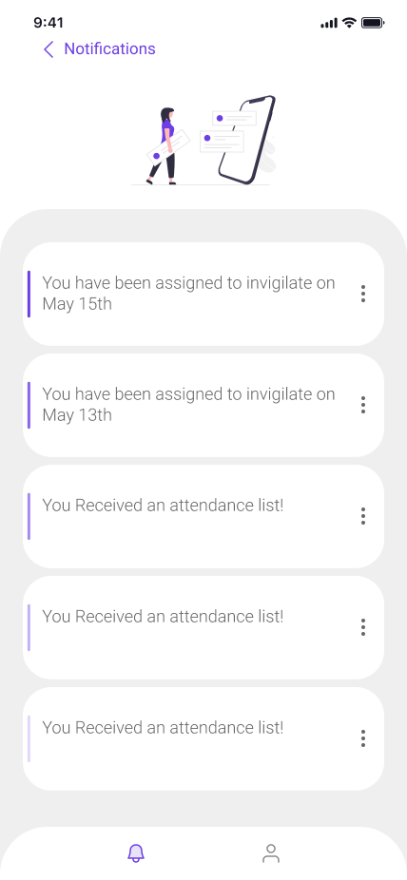
Instructor Interface
Notifications’ Interface
34
Danah
Notes:
Notifications: The Instructor is notified when they are appointed as an invigilator and can switch to the invigilator interface when the menu icons are pressed. Also, upon receiving a list of students' names, the instructor is notified, and the list is uploaded via the three dots.

Slide 35
08
Conclusion & Recommendations
35
Lamia
Notes:
To summarize, Exam attendance is one of the tasks that should be automated in CCSIT. The traditional way of taking exam attendance is inefficient, takes a lot of time, disrupts exam rooms, and isn't very accurate. Students at CCSIT can use HADER to make sure that they show up for their exams on time. It lets the academic affairs unit manage attendance and exams, and it makes it easy for invigilators to scan students' QR codes and automatically record their attendance in the academic affairs unit's databases. Students can also send in their excuses, which will be approved or not by the Academic Affairs Unit. Finally, the application will be built with high security, and high authentication techniques to verify and validate the whole attendance process.
Recommendations for future work
1. Create a desktop version of the system for all users.
2. Integrate solution into IAU database for all IAU colleges and facilities.
3. Allow the admin to take invigilator attendance to ensure they arrive on time.
4. Validating if the student is in the correct exam hall.
5. Enable location access and GPS to notify students and invigilators that your exam is in this hall if they pass by.

Slide 36
Conclusion
Recommendations
Create a desktop version of the system.
Integrate the app into IAU database for all IAU colleges and facilities.
Allow the admin to take invigilator attendance to ensure they arrive on time.
Validating if the student is in the correct exam hall.
Enable location access and GPS to notify students and invigilators that your exam is in this hall if they pass by.
Exam attendance should be automated in CCSIT.
HADER Allows the academic affairs unit manage attendance and exams.
Enables invigilators to scan students’ QR codes.
Enables students to send excuses
The application will be built with high security.
36
Lamia
Notes:
To summarize, we think that Exam attendance is one of the tasks that should be automated in CCSIT. The traditional way of taking exam attendance is inefficient, takes a lot of time, disrupts exam rooms, and isn't very accurate. Students at CCSIT can use HADER to make sure that they show up for their exams on time. It lets the academic affairs unit manage attendance and exams, and it makes it easy for invigilators to scan students' QR codes and automatically record their attendance in the academic affairs unit's databases. Students can also send in their excuses, which will be approved or not by the Academic Affairs Unit. Finally, the application will be built with high security, and high authentication techniques to verify and validate the whole attendance process.
Recommendations for future work
1. Create and publish the desktop version of the system for all users to use.
2. Integrate the solution into the IAU database for use by all IAU colleges and facilities.
3. Allow the administrator to take invigilator attendance to ensure that invigilators arrive at the exam rooms on time.
4. Including a check to see if the student is in the correct exam hall.
5. Adding location access and GPS functionality to notify students and invigilators that your exam is in this hall if they pass by the exam hall.

Slide 37

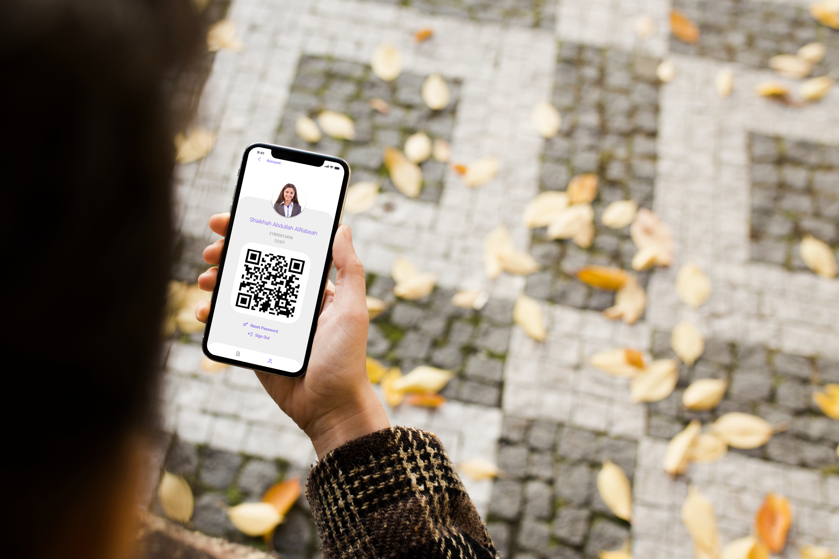
Thank You! Any Questions?

